Slide 1
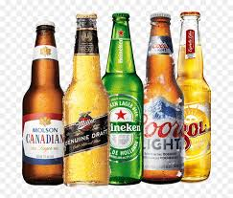
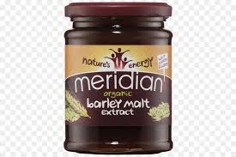
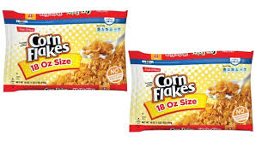
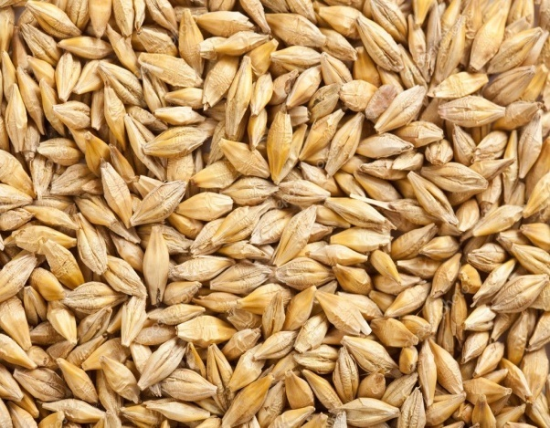
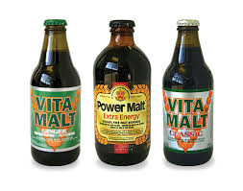
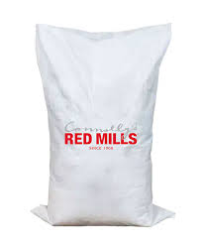
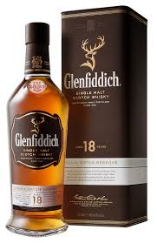
Uses of Barley(Jau)

Slide 2
Near Infrared Spectroscopy for Procurement
Barley of different quality is required to different uses
Procurement of different kinds of barley material needs expertise, time and experienced personnel not easily available
NIRS based models make is easy , fast and do not required experienced professionals.

Slide 3
Advantages of NIRS Model
NIRS based models can be developed tailored to different needs.
Requires small amount of sample approx. 5 gm
Provides precise predicted compositional values such as Protein content, starch content etc of the sample
Is important tool for grain quality-based procurement

Slide 4
Models developed for Malt quality
NIRS models were developed for five biochemical parameters,
    β-Glucan content
    Phenol content
    Starch content
    Protein content
    Amylose content
Models are based on broad diversity range utilizing the vast diverse germplasm available at ICAR-NBPGR.
Models are robust with prediction range for wide variability.

Slide 5
Who can use
Farmers
Breeders
Agri tech companies
Maltsters
Brewers
Craft Brewery's
Food companies
Feed companies

