Slide 1
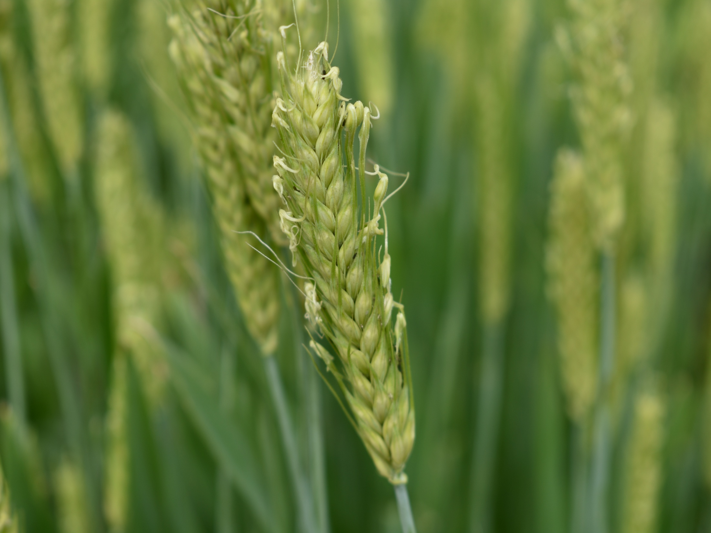

NIRS prediction modeling and association mapping for biochemical traits related to malting in barley
Post comprehensive(14) SRC Meeting
Shakti Khera
1800264RSP
PhD Scholar
Supervisor – Dr. S.B. Tripathi
Department of Biotechnology
TERI SAS
Co-Supervisor – Dr. Rakesh Bhardwaj
Department of Germplasm Evaluation
ICAR-NBPGR

Slide 2
SRC Members
Dr. Shashi Bhushan Tripathi (Supervisor)
Dr. Rakesh Bhardwaj, NBPGR (Co-supervisor)
Dr. Anandita Singh
Dr. Chaithanya Madhurantakam

Slide 3
Objectives
Developing NIRS calibration models for selected biochemical traits related to malting in barley.
Identification of SNPs associated with select biochemical traits related to malting.

Slide 4
Timelines
Objective | Activity | Years
 |  | 1-2 | 2-3 | 3-4 | 4-5 | 5-6 | 6-7
I | Sample acquisition
 | NIR spectra acquisition of all the samples
 | Selection of diverse germplasm
 | Chemical analysis of representative set
 | Development of NIRS prediction model
 | Validation of NIRS prediction model
II | GBS of selected elite lines (~100 accessions)
 | Association mapping for targeted traits
Yet to be initiated
Ongoing
Completed

Slide 5
Work done (January 2025 to June 2025)
GWAS analysis Completed
Revision of manuscript for submission with Cereal Chemistry
Draft Thesis for submission

Slide 6
Thank You

